Slide 1

Industrial Training II
Amazon Sentiment Analysis
By
Jyotirmoy Das(202200016)
In partial fulfillment of requirements for the award of degree in
Bachelor of Technology in Computer Science and Engineering (Computer Science and Engineering)
(2025)
Department of Computer Science and Engineering
Sikkim Manipal Institute of Technology
(A constituent college of Sikkim Manipal University)
Majitar, Rangpo, East Sikkim – 737136

Slide 2
S No. | Content | Page No.
1 | Abstract | 2
2 | Introduction | 3
3 | Design and Methodology | 4-6
4 | Result | 7-9
5 | Conclusion | 10
6 | References | 11

Slide 3
Abstract
This project presents a sentiment analysis system for Amazon product reviews using Natural Language Processing (NLP) and Machine Learning techniques. The aim is to classify customer reviews into positive, neutral, or negative sentiments based on their star ratings. The methodology involves preprocessing review text, feature extraction using TF-IDF, and training a Logistic Regression classifier. The model achieves high accuracy in sentiment classification and provides insights into customer satisfaction trends. This project demonstrates the potential of sentiment analysis in improving business decision-making and customer engagement.

Slide 4
Introduction
Nowadays, online reviews show what customers think about products and help businesses improve. Sentiment analysis uses Natural Language Processing (NLP) and Machine Learning to automatically classify reviews as positive, negative, or neutral. This project uses these methods to analyze Amazon product reviews and build a model that helps businesses understand customer opinions and make better decisions.

Slide 5
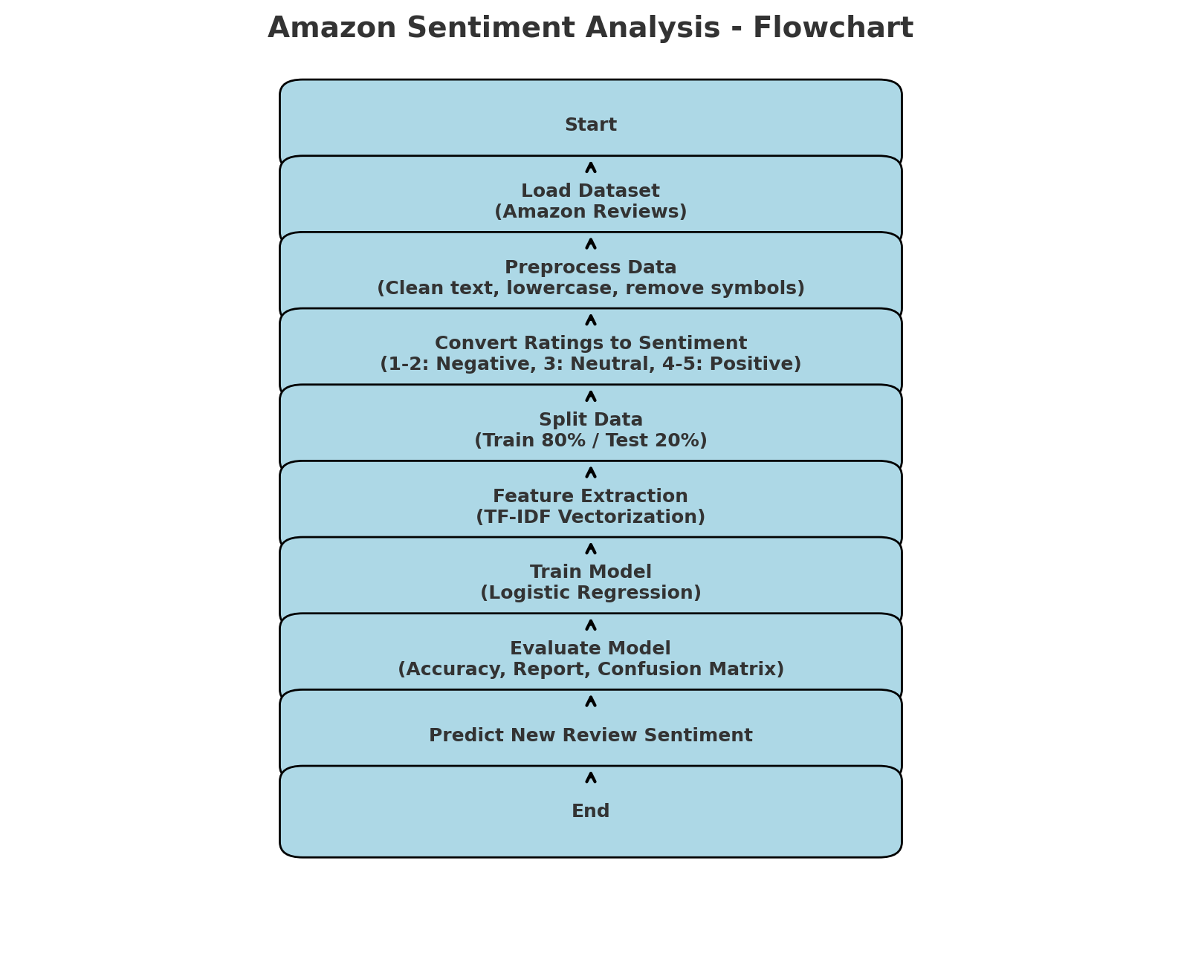
Design and Methodology
Load Dataset:
■ Import the CSV file containing Amazon reviews with columns reviewText and overall (ratings).
Preprocess Text:
■ Convert all review text to lowercase.
■ Remove special characters, numbers, and punctuation.
■ Store the cleaned text in a new column (cleaned_review).
Convert Ratings to Sentiment Labels:
■ Map star ratings to sentiment categories:
◆ 1–2 → Negative
◆ 3 → Neutral
◆ 4–5 → Positive
●

Slide 6
Design and Methodology
Split Dataset:
Divide the data into training (80%) and testing (20%) sets.
Feature Extraction:
Apply TF-IDF Vectorization to transform text into numerical features suitable for the model.
Train Model:
Use Logistic Regression to train the model on the training dataset.
Evaluate Model:
Test the model on the testing dataset.
Calculate accuracy, precision, recall, F1-score, and generate a confusion matrix.
Predict New Reviews:
Preprocess new review text, transform it with TF-IDF, and use the trained model to predict the sentiment.

Slide 7
Design and Methodology
The Amazon Sentiment Analysis project follows several key steps. Data Collection involves gathering Amazon product reviews from a CSV file containing review text and star ratings, ensuring a diverse and representative dataset. Data Preprocessing cleans the text by converting it to lowercase, removing special characters, and handling missing values, storing the processed text in a new column.
Sentiment Labeling maps star ratings to three categories: negative (1–2 stars), neutral (3 stars), and positive (4–5 stars), making the dataset suitable for supervised learning. Feature Extraction uses TF-IDF to convert text into numerical vectors that reflect the importance of words in each review.
During Model Training, the data is split into training (80%) and testing (20%) sets, and a Logistic Regression classifier learns patterns between TF-IDF features and sentiment labels. Model Evaluation measures performance using accuracy, classification reports, and a confusion matrix to assess how well the model predicts unseen reviews.
Finally, Prediction on New Reviews applies the same preprocessing and TF-IDF transformation to new review text, allowing the trained model to classify sentiments automatically, providing actionable insights for businesses and researchers.

Slide 8
Result
Confusion Matrix:
The confusion matrix is a table that shows how well the sentiment classification model performed by comparing predicted labels with actual labels.
· Rows represent the actual sentiment classes.
· Columns represent the predicted sentiment classes.
Assuming the order of classes is [Negative, Neutral, Positive]
[[ 25 0 45]
[ 1 0 24]
[ 2 0 886]]

Slide 9
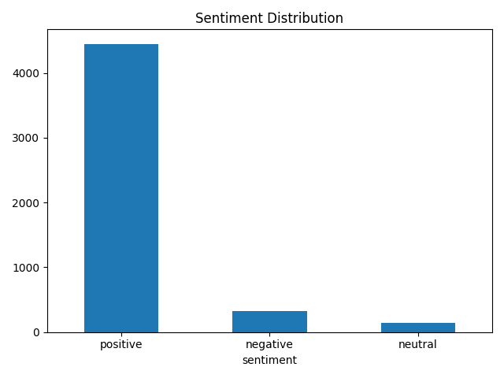
Result
Classification Report:
precision recall f1-score support
negative 0.89 0.36 0.51 70
neutral 0.00 0.00 0.00 25
positive 0.93 1.00 0.96 888
accuracy 0.93 983
macro avg 0.61 0.45 0.49 983
weighted avg 0.90 0.93 0.90 983

Slide 10
Conclusion
The Amazon Sentiment Analysis project uses NLP and Machine Learning to classify customer reviews as positive, neutral, or negative. By preprocessing text, applying TF-IDF feature extraction, and training a Logistic Regression model, it predicts review sentiment with good accuracy, especially for positive reviews. While neutral and negative predictions are less accurate, the project provides valuable insights for businesses and demonstrates practical applications of sentiment analysis, with potential for improvements like deep learning or real-time monitoring.

Slide 11
Reference
Amazon Customer Reviews Dataset: https://registry.opendata.aws/amazon-reviews/
Pang, B., & Lee, L. (2008). Opinion Mining and Sentiment Analysis. Foundations and Trends in Information Retrieval, 2(1–2), 1–135.
Zhang, L., Wang, S., & Liu, B. (2018). Deep Learning for Sentiment Analysis: A Survey. Wiley Interdisciplinary Reviews: Data Mining and Knowledge Discovery, 8(4), e1253.

Slide 12
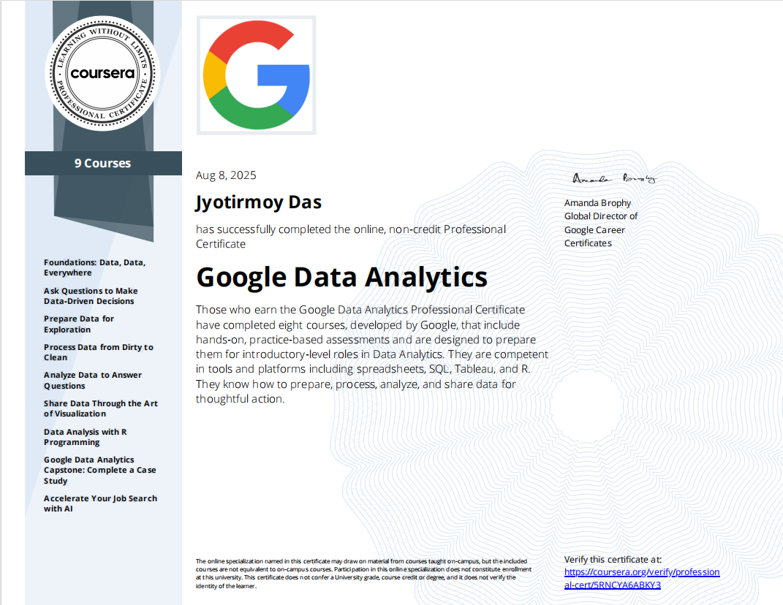

Slide 13
THANK YOU

